Slide 1
PRIORITY-BASED PRE-BOOKING SYSTEM FOR EV CHARGING STATIONS ENABLING EMERGENCTY VEHICLE ACCESSIBILITY.
SDG GOAL : 7 (Affordable and Clean Energy)
TEAM MEMBERS:
SANJAY VISHWANATH A [211420104241]
SAI AVAINASH REDDY V [211420104298]
SUDARSHAN R [211420104273]
GUIDED BY
Mr.C.THYAGARAJAN,
M.E.,(Ph.D.), SUPERVISOR

Slide 2
OBJECTIVES
Implement a priority-based EV charging strategy to manage EV load demands and minimize grid peak load.
Develop a scheduling strategy for efficient charging and discharging of EVs based on user-selected priority levels.
Design a charging station strategy to balance the grid load and shift EV charging to off-peak hours.
Propose a priority-based pre-booking system that enables emergency vehicle accessibility to charging stations.
Utilize advanced reservation mechanisms in the pre-booking system to allocate charging slots to EV owners based on their priority level.

Slide 3
ABSTRACT
The growing popularity of electric vehicles (EVs) has led to an increased demand for electric vehicle charging infrastructure. However, limited charging station availability and the need for efficient utilization have become significant challenges in ensuring seamless charging services for EV owners. In emergency situations, such as medical emergencies or other critical incidents, it becomes crucial to provide unimpeded access to EV charging stations for emergency vehicles. To address this issue, we propose a priority-based pre-booking system that enables emergency vehicle accessibility to charging stations. The priority-based pre-booking system utilizes advanced reservation mechanisms to allocate charging slots to EV owners based on their priority level.

Slide 4
INTRODUCTION
This paper proposes a priority-based EV charging strategy to minimize grid peak load and manage EV load demands.
It presents a scheduling strategy for charging and discharging of EVs based on user-selected priority levels.
A charging station strategy is designed to balance the grid load and shift EV charging to off-peak hours.
It explores the potential of using solar rooftops and incentive structures to encourage off-peak charging and grid energy feedback.

Slide 5
LITERATURE SURVEY
SNO | YEAR | AUTHORS | PAPER TITLE | METHODOLOGY | LIMITATIONS
1 | 2020 | Yuanbo Jiang, Zhen Liu | EV CHARGING STATION LOCATION WITH SLOT BOOKING STSTEM | Display SoC, suggest nearest stations, enable slot booking | Time-consuming charging, demanding more stations
2 | 2020 | Sourabh Jamadagni | Vehicle Charging Control System Based On Characteristic of Charging Power | Design charging scheduling protocols, use solar panels | Unpredictable driving profile of EV users, large EV charging load affecting grid stability

Slide 6
SNO | YEAR | AUTHORS | PAPER TITLE | METHODOLOGY | LIMITATIONS
3 | 2021 | Meng Song and Mikael Amelin | OPTIMIZED OPERATIONAL MANAGEMENT OF AN EV SHARING COMMUNITY INTEGRATED WITH BATTERY ENERGY STORAGE AND PV GENERATION | Coordinate charging, reservation, integrate PV and battery storage | Depends on accurate Swedish travel patterns, effective coordination
4 | 2020 | Sara Maher, Guillaume Remy | EV-Planning: Electric Vehicle Itinerary Planning | Propose advanced EV fleet management, compute best routes, implement traffic management server | Autonomy barriers, limitations in technology deployment, reliance on accurate data collection
5 | 2020 | Marek Cuchý | Benefits of Multi-Destination Travel Planning for Electric Vehicles | Advanced EV travel planning, multi-destination perspective, agent-based simulation | Dependent on charging capacity, real-world data accuracy, upfront booking support

Slide 7
SNO | YEAR | AUTHORS | PAPER TITLE | METHODOLOGY | LIMITATIONS
6 | 2019 | Daniel FODOREAN | New Mobile Charging Station for Urban and Resort Areas | Use AC and DC grids, store energy on hybrid source, deliver to EVs, simulate operations | Dependent on grid availability, effective energy transfer, and storage capacity
7 | 2018 | Badrinath Kulkarni | IOT Based PV assisted EV Charging Station for Confronting Duck Curve | Study effects, create IOT stations, propose taxation | Depends on solar availability, IOT integration, off-peak charging participation
8 | 2014 | Xinyi Lu | Multi-objective Optimal Scheduling of a DC Microgrid Consisted of PV System and EV Charging Station | Optimal scheduling of DC micro-grid, mathematical model, NSGA-II solution | Constraints on charging time, power, SOC, power supply rate, system balance

Slide 8
SNO | YEAR | AUTHORS | PAPER TITLE | METHODOLOGY | LIMITATIONS
9 | 2019 | Rares Catalin NACU | Battery Cells Characterization for Subsequent Operation in Battery Models used in Mobile Charging Station Designing | Battery cell characterization, numerical and experimental analysis, Matlab/Simulink simulation | Reliability of method, lack of EVSE, long charging periods
10 | 2020 | Ninet Varghese | Health Monitoring and Observatory System for Paralysed Patients using Blynk Application | Monitor different vital information and also help the patients to convey their messages to the bystanders | Data Reliability Can Be Affected

Slide 9
EXISTING SYSTEM
In the existing system No PRE-BOOKING EV charging is not available.
The priority-based pre-booking system does not utilize advanced
reservation mechanisms to allocate charging slots to EV owners based on
their priority level.
The system does not categorize users into different priority tiers, with
emergency vehicles are assigned the highest priority.
Increasing waiting times for EV owners while compromising emergency
vehicle accessibility.

Slide 10
DEMERITS
No Pre-Booking
No Advanced Reservation Mechanism
No User Categorization
Increased Waiting Times
Compromised Emergency Vehicle Accessibility

Slide 11
PROPOSED SYSTEM
In the proposed system PRE-BOOKING EV charging system is available.
The priority-based pre-booking system utilizes advanced reservation
mechanisms to allocate charging slots to EV owners based on their priority
level.
The system categorize users into different priority tiers, with
emergency vehicles are assigned the highest priority.
Reduce waiting times for EV owners, and ensure emergency vehicle
accessibility.

Slide 12
MERITS
This can lead to shorter waiting times and convenience for EV owners
EV charging slot controlling is easy
Improved Efficiency
Enhanced User Experience
Optimized Energy Management
Priority Service for Emergency Vehicles

Slide 13
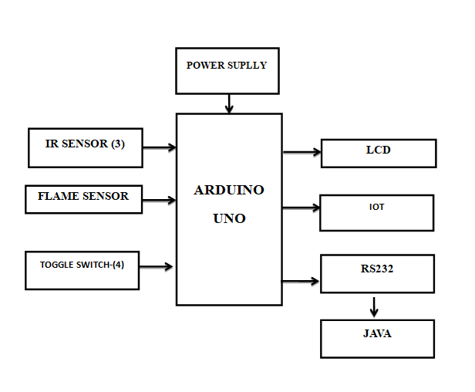
ARCHITECTURE DIAGRAM

Slide 14
MODULES
Priority Assignment Module
Reservation and Booking Management Module
Resource Optimization and Efficiency Module

Slide 15
PRIORITY ASSIGNMENT MODULE
This module categorizes users into different priority tiers and assigns
emergency vehicles are the highest priority, ensuring they have
immediate access to charging stations when needed.
The IR sensor is used for knowing the slot status and the flame sensor is
used for fire accidents in EV stations.

Slide 16
RESREVATION AND BOOKING MANAGEMENT MODULE
This module handles the reservation process, allowing EV owners to pre-book charging slots based on their anticipated requirements.
The real-time updates on charging station availability, four toggles are used for the price variant based on EV owners booking each switch is for Morning, Afternoon, Evening and Night, this system reduces the crowd at stations in real-time.

Slide 17
RESOURCE OPTIMIZATION AND EFFICIENCY MODULE
This module focuses on optimizing the allocation of charging slots, reducing waiting times for EV owners, minimizing congestion, and overall improving the efficiency of the charging infrastructure.
It ensures that charging stations are utilized effectively while accommodating emergency vehicles seamlessly, Java is used for update all the vehicle charged data in database securely.

Slide 18
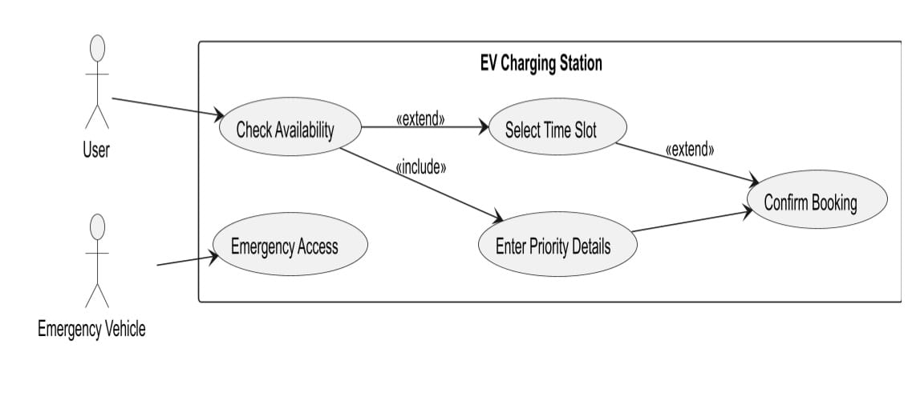
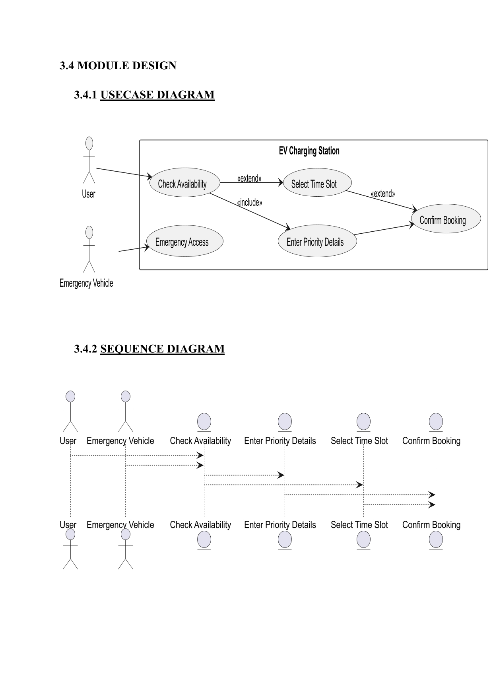
USECASE DIAGRAM

Slide 19
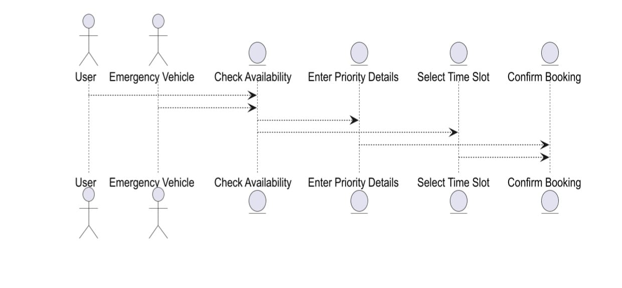
SEQUENCE DIAGRAM

Slide 20
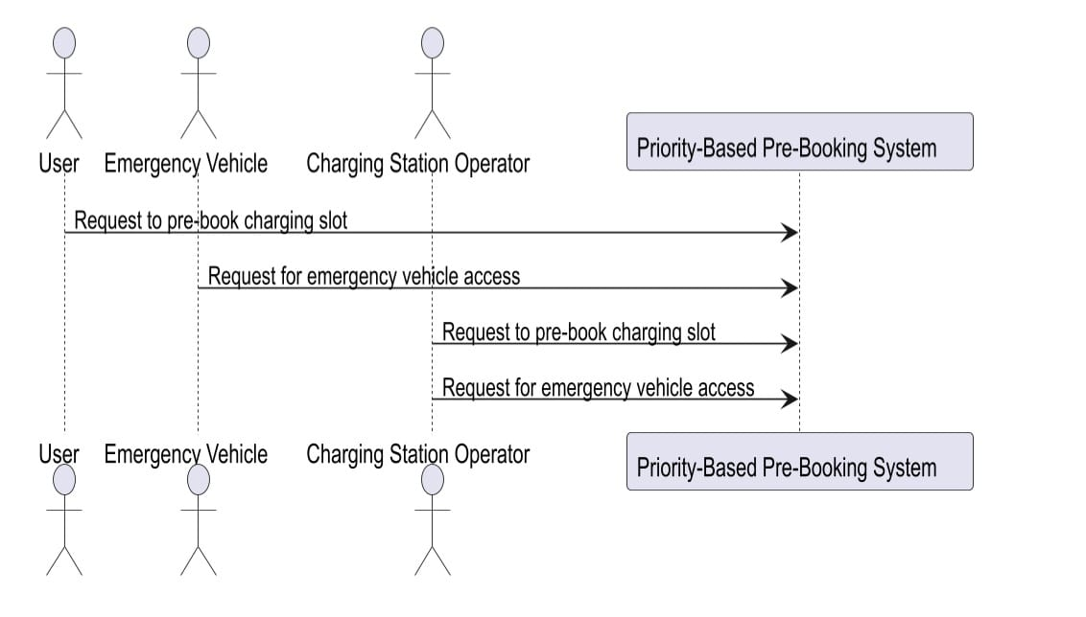
DATAFLOW DIAGRAM

Slide 21
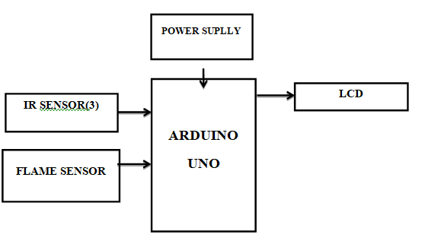
BLOCK DIAGRAM

Slide 22
SYSTEM REQUIREMENTS
SOFTWARE REQUIREMENTS:
Arduino Software Ide.
Embedded C Language
Java Language

Slide 23
SYSTEM REQUIREMENTS
HARDWARE REQUIREMENTS
ARDUINO UNO
LCD
POWER SUPPLY
IR SENSOR
TOGGLE SWITCH
FIRE/FLAME SENSOR
ESP-12E MICROCONTROLLER
SINGLE-CHIP USB-TO-UART BRIDGE

Slide 24

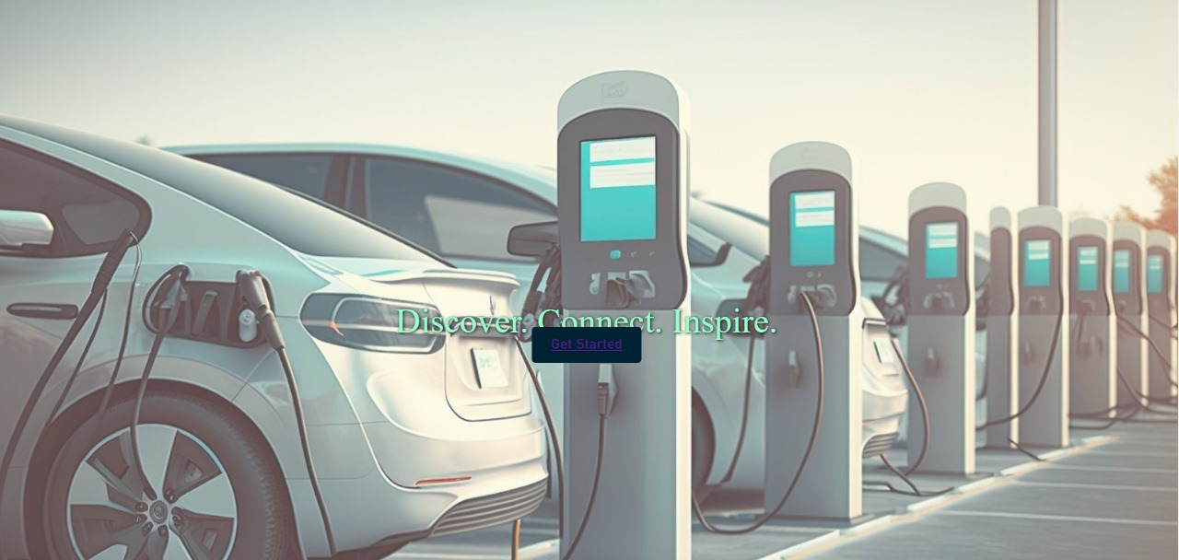
DEMO SLIDES

Slide 25
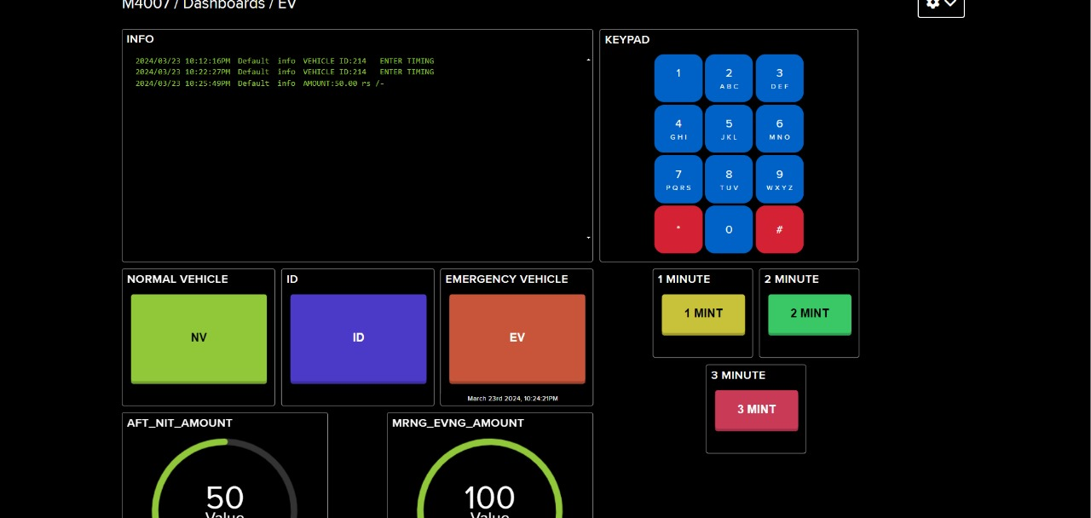
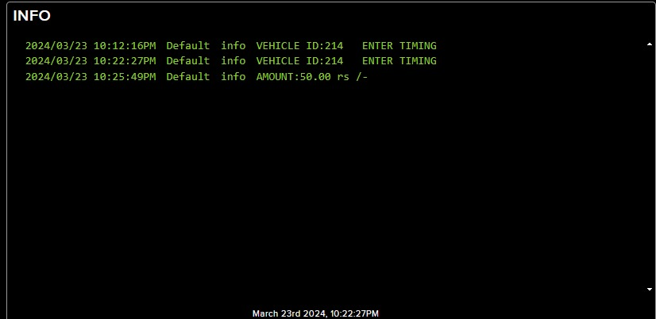

Slide 26
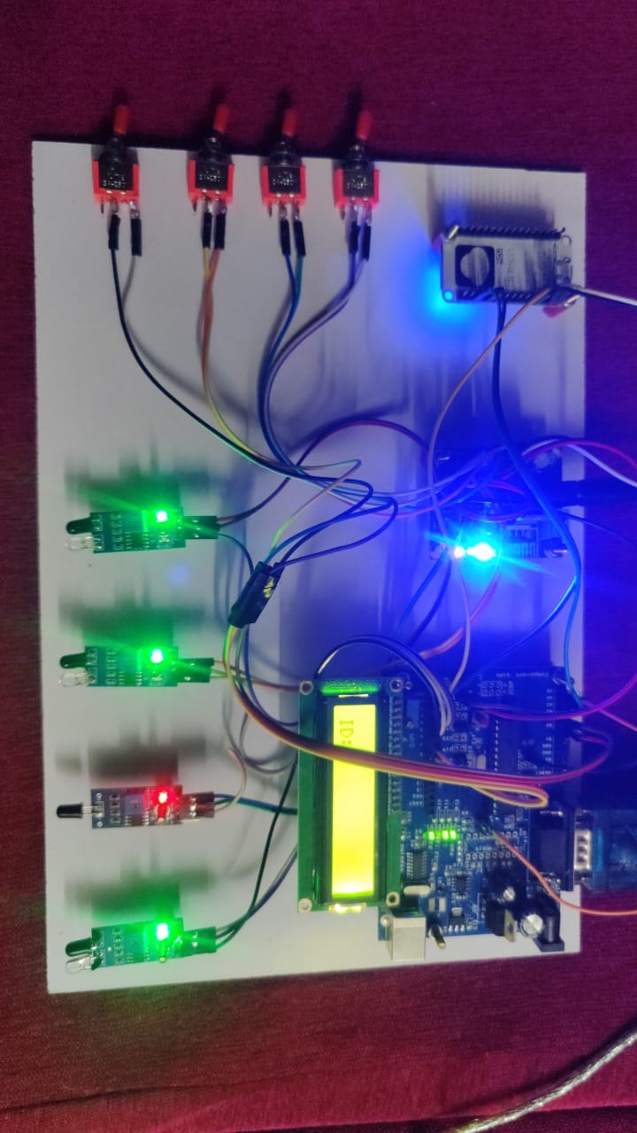

Slide 27
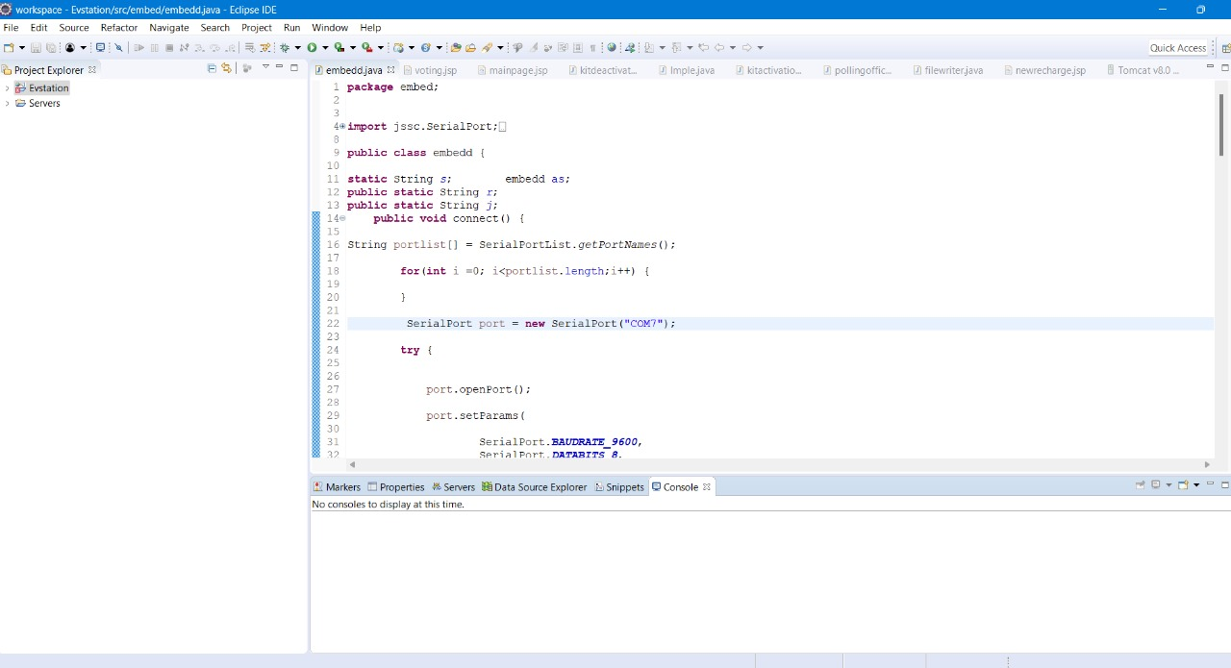

Slide 28
CONCLUSION
Electric vehicles can play a role of game changer to create a balanced electric
network in future by using renewable energy sources. Furthermore, as the number of EVs is expected to increase, proper scheduling is important in the energy supply system. In this paper, we propose a new approach for balancing the grid peak load and scheduling charging according to EV user priority. Selection of priority by EV users will lead to a reduced cost of charging. Varying priority levels can be made available to reduce the peak-hour load on the grid by shifting the load to renewable sources or to off-peak hours for EV charging. This approach can be applied to achieve load minimization. Priority selection by EV users can help to flatten the peak load curve of the grid.

Slide 29
FUTURE ENHANCEMENTS
In the future, the priority-based pre-booking system for EV charging stations
could further evolve by integrating predictive analytics and artificial
intelligence. By analyzing historical data and real-time traffic patterns, the
system could anticipate high-demand periods and proactively allocate
charging slots to prioritize both emergency vehicles and EV owners with
urgent charging needs. Moreover, the platform could explore partnerships
with smart grid technologies to optimize charging schedules based on
renewable energy availability, reducing the environmental impact of EV
charging. Additionally, considering the ever-expanding EV market, the system
could expand its priority tiers to accommodate different types of priority users,
such as public transportation fleets and shared mobility services

Slide 30
REFERENCES
[[1] A. Jindal, G. Aujla and N. Kumar, ”SURVIVOR: A blockchain based edgeas-a-service framework for secure energy trading in SDN-enabled vehicle-to-grid environment”, Computer Networks, vol. 153, pp. 36-48, 2019..
[2] S. Aggarwal, R., G. Aujla, N. Kumar, K. Choo A. Zomaya, ”Blockchain for smart communities: Applications, challenges and opportunities”, Journal of Network and Computer Applications, 144, 13-48, 2019.
[3] Y. Cao, O. Kaiwartya, C. Han, and K. Wang, “Electro-Mobility Using Publish / Subscribe System,” IEEE Trans. Veh. Technol., vol. 67, no. 11, pp. 10204– 10217, 2018.
[4] Y. Cao et al., ”Toward Efficient, Scalable, and CoordinatedOnthe-Move EV Charging Management,” in IEEE Wireless Communications, vol. 24, no. 2, pp. 66-73, April 2017, doi: 10.1109/MWC.2017.1600254WC.
[5] M. Ahmed and Y.-C. Kim, “Energy Trading with Electric Vehicles in Smart Campus Parking Lots,” Applied Sciences, vol. 8, no. 10, p. 1749, Sep. 2018, doi: 10.3390/app8101749. .

Slide 31
[[6] Y. Cao et al., ”Mobile Edge Computing for Big-DataEnabled Electric Vehicle Charging,” in IEEE Communications Magazine, vol. 56, no. 3, pp. 150-156, March 2018, doi: 10.1109/MCOM.2018.1700210.
[7] S. Aggarwal, R. Chaudhary, G. S. Aujla, A. Jindal, A. Dua, and N. Kumar, “EnergyChain: Enabling energy trading for smart homes using blockchains in smart grid ecosystem,” Proc. 1st ACM MobiHoc Work. Netw. Cybersecurity Smart Cities, SmartCitiesSecurity 2018, 2018.
[8] M. N. M. Bhutta et al., ”A Survey on Blockchain Technology: Evolution,Architecture and Security,” in IEEE Access, vol. 9, pp. 61048-61073, 2021,doi: 10.1109/ACCESS.2021.3072849.
[9] M. Mihaylov, S. Jurado, N. Avellana, K. Van Moffaert, I. M. de Abril and A.Nowe´, ”NRGcoin: Virtual currency for trading of renewable energy in smart grids,” 11th International Conference on the European Energy Market (EEM14), 2014, pp. 1-6, doi: 10.1109/EEM.2014.6861213.
[10] S. Wang, A. F. Taha, J. Wang, K., and A. Hahn, “Energy Crowdsourcing and Peer-to-Peer Energy Trading in BlockchainEnabled Smart Grids,” IEEE Trans. Syst. Man, Cybern. Syst., 49, 8, 1612–1623, 2019. .

Slide 32
THANK YOU

